Slide 1

Process

Slide 2
A program under execution is called process. When a program is loaded to the main memory and starts its execution then it is called a process.

Slide 3
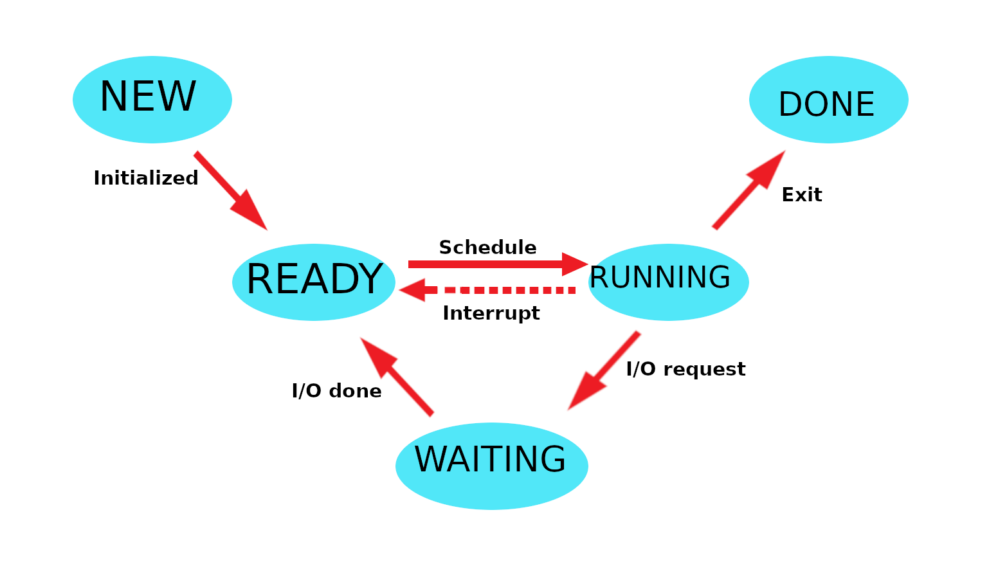
States of the process:-

Slide 4
1. New: The process is being created. 2. Running: Instructions are being executed. 3. Waiting: The Process is waiting for some event to occur(such as an I/O completion or reception of a signal). 4. Ready: The Process is waiting to be assigned to a processor. 5. Terminate: The process has finished execution.

Slide 5


Slide 6

CPU Scheduling

Slide 7
CPU Scheduling is a process of determining which process will own CPU for execution while another process is on hold.

Slide 8
CPU Scheduler
CPU scheduler will select a process from the ready process from the memory and will allocate the CPU to that process. CPU scheduling decisions occur when a process:-
Switches from "Running" to "Waiting" state.
Switches from "Running" to "Ready" state.
Switches from "Waiting" to "Ready".
Terminates.

Slide 9
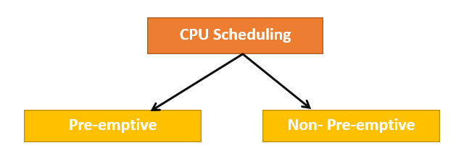
Types of CPU Scheduling

Slide 10
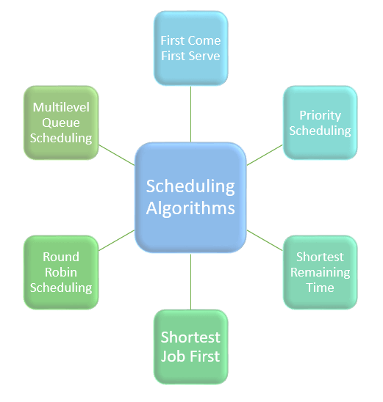
Types of CPU scheduling Algorithm

Slide 11
First Come First Serve (FCFS)
Shortest-Job-First (SJF)
Shortest Remaining Time
Priority Scheduling
Round Robin Scheduling
Multilevel Queue Scheduling

Slide 12
1. Burst time (BT): The time required for the execution of the process
2. Arrival time (AV): The time at which the process enters the ready queue.
3. Completion Time/Finish Time /Exit time (CT) :it is when a process finishes execution and is no longer being processed by the CPU. It is the summation of the arrival, waiting, and burst times.
4. Turnaround time (TAT): time elapsed between the arrival of a process and its completion is known as turnaround time. That is, the duration it takes for a process to complete its execution and leave the system.
Turnaround Time = Completion Time – Arrival Time
5. Waiting time (WT): The time spent by the process in ready state i.e., the difference between turnaround time and burst time.
6. Response time: The time taken by a process, to be allocated to the CPU, for the first time after entering ready queue i.e., the difference between the time a process first gets CPU and the arrival time
7. Throughput: This is a way to find the efficiency of a processor. It is the number of processes executed by the CPU in a given amount of time.

Slide 13
TAT = (CT-AT) or (WT+BT)
WT = TAT-BT
RT = AT- Time allocated to the CPU, for the first time

Slide 14
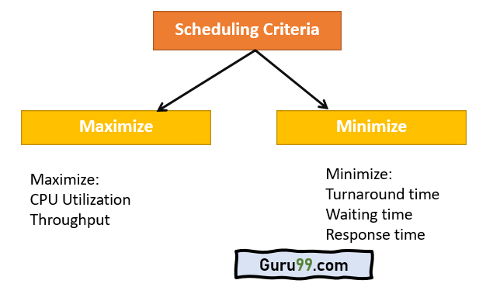
CPU Scheduling Criteria

Slide 15
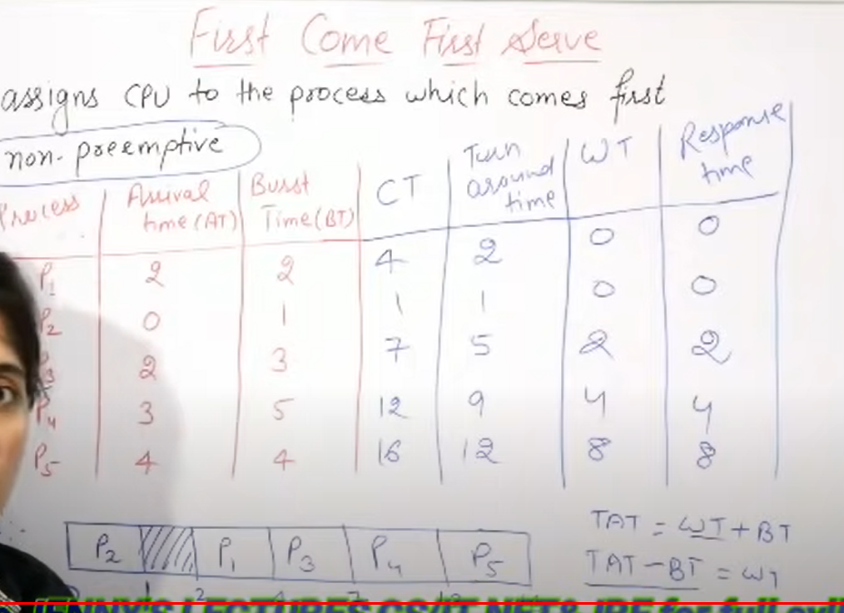

Slide 16
Problems with FCFS Scheduling
It is Non Pre-emptive algorithm, which means the process priority doesn't matter
Not optimal Average Waiting Time.
Resources utilization in parallel is not possible, which leads to Convoy Effect, and hence poor resource(CPU, I/O etc) utilization.

Slide 17
What is Convoy Effect?
Convoy Effect is a situation where many processes, who need to use a resource for short time are blocked by one process holding that resource for a long time.
This essentially leads to poor utilization of resources and hence poor performance.

Slide 19


Slide 20
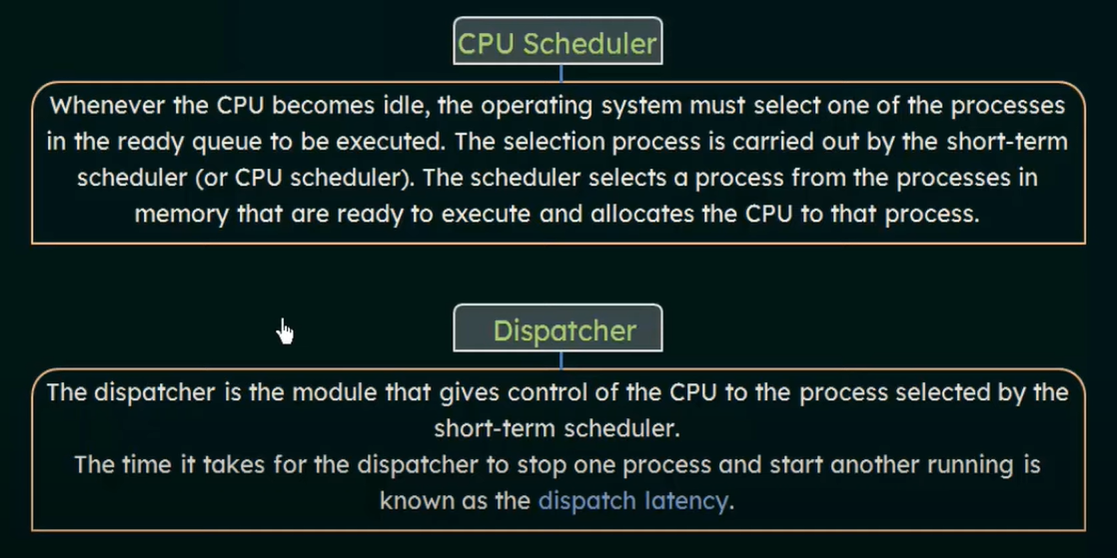

Slide 21


Slide 22
Types of Priority Scheduling Algorithm
Priority scheduling can be of two types:
Preemptive Priority Scheduling: If the new process arrived at the ready queue has a higher priority than the currently running process, the CPU is preempted, which means the processing of the current process is stopped and the incoming new process with higher priority gets the CPU for its execution.
Non-Preemptive Priority Scheduling: In case of non-preemptive priority scheduling algorithm if a new process arrives with a higher priority than the current running process, the incoming process is put at the head of the ready queue, which means after the execution of the current process it will be processed.

Slide 23
Characteristics of Priority Scheduling
Schedules processes on the basis of priority.
Used to perform batch processes.
In the case of two processes with similar priorities, we use FCFS and Round-Robin to choose between them.
A number is given to each process to indicate its priority level.
Lower is the number assigned, higher is the priority level of a process.
If a higher priority task arrives when a lower priority task is executing, the higher priority task replaces the one with lower priority and the
latter is put on hold until it completes execution.

Slide 24
Problem with Priority Scheduling Algorithm
->In priority scheduling algorithm, the chances of indefinite blocking or starvation.
->A process is considered blocked when it is ready to run but has to wait for the CPU as some other process is running currently.
->But in case of priority scheduling if new higher priority processes keeps coming in the ready queue then the processes waiting in the ready queue with lower priority may have to wait for long durations before getting the CPU for execution.
->In 1973, when the IBM 7904 machine was shut down at MIT, a low-priority process was found which was submitted in 1967 and had not yet been run.

Slide 25
Using Aging Technique with Priority Scheduling
To prevent starvation of any process, we can use the concept of aging where we keep on increasing the priority of low-priority process based on the its waiting time.
For example, if we decide the aging factor to be 0.5 for each day of waiting, then if a process with priority 20(which is comparitively low priority) comes in the ready queue. After one day of waiting, its priority is increased to 19.5 and so on.
Doing so, we can ensure that no process will have to wait for indefinite time for getting CPU time for processing.

Slide 26
Solve problem in class

Slide 27
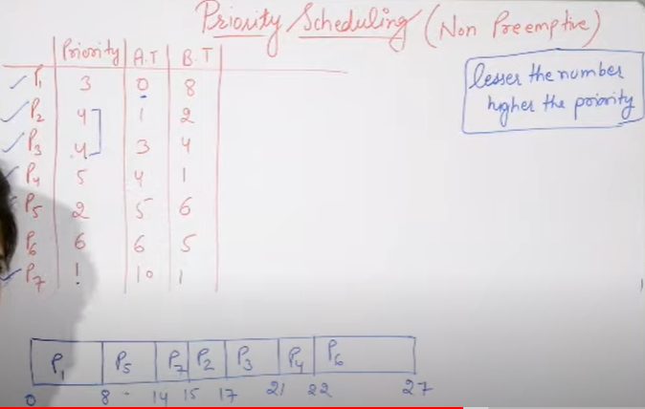
Non-Preemptive Priority Scheduling

Slide 28
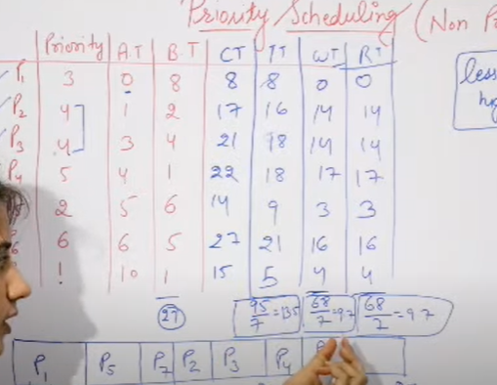

Slide 29
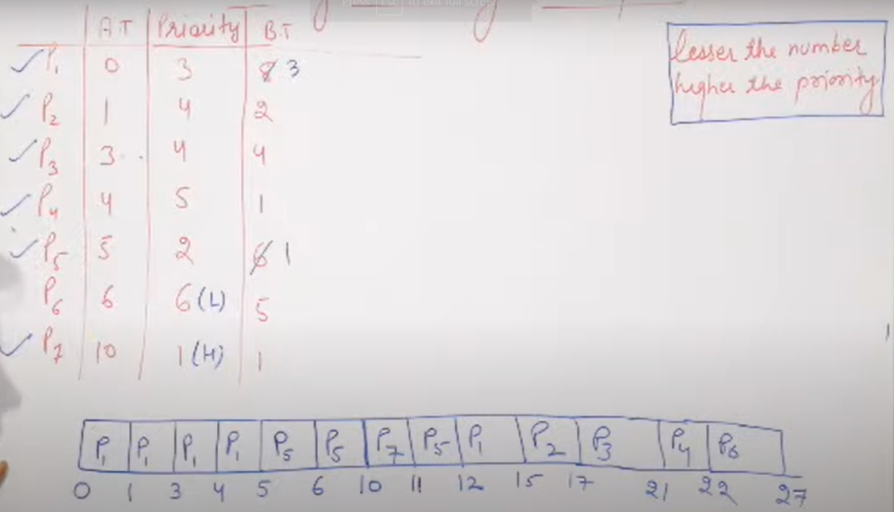
Preemptive Priority Scheduling

Slide 30
